Slide 1

Project 6 – Linear Regression for Marketing
MA0009 Project Presentation, 10/12/2024
Group members: Mustafa Iqbal, Aliyah Zaman, Silvia Botoaca, Deividas Talocka and Baurneegan Kanesalingam
Group leader: Deividas Talocka

Slide 2

Table of contents
Project Title - Slide 1
Table of Contents – Slide 2
Project Tasks – Slide 3
How we did it – Slide 4
Scatterplot – Slide 5
Regression Analysis – Slide 6
Residual Analysis – Slide 7
Confidence Intervals – Slide 8
Hypothesis Test – Slide 9
Hypothesis Test Extended – Slide 10
Conclusions – Slide 11
References – Slide 12

Slide 3
Project tasks
Create a scatter plot to examine the relationship between TV advertising expenditure and sales. Justify choice of explanatory and response variables.
Calculate the correlation coefficient and derive the regression line equation, using it to make predictions and interpret the coefficients and coefficient of determination.
Assess the validity of the regression model by analysing the residuals for any patterns or inconsistencies.
Construct 95% and 99% confidence intervals for the data and explain why the 99% interval is wider.
Evaluate the claim that the average expenditure on TV advertising by clients is £14,000 using appropriate statistical tests.

Slide 4

How we did it
We divided the tasks into five tasks, with each group member handling one task
Task 1 (scatterplot) – Deividas
Task 2 (regression analysis) – Silvia
Task 3 (residual analysis) – baurneegan
Task 4 (confidence intervals) –mustafa
Task 5 (hypothesis testing) – Aliyah
We used WhatsApp to communicate, share updates and ensure everyone stayed on track

Slide 5
scatterplot and explanatory/response variables
Used excel to plot a scatter chart of tv ads vs sales, added axis titles and included a trendline (see figure 1)
Scatter plot indicates a positive relationship: higher ad spend generally leads to increased sales
Tv advertising expenditure is the explanatory variable (controllable factor) and Sales is the response variable (affected by advertising spend)
Figure 1

Slide 6
Regression Analysis
Correlation Coefficient: r = 0.7822
  The explanatory variable (TV ads) and response variable (Sales) have a strong positive correlation.
Equation of the Regression Line: y = 0.0475x + 7.0326
  slope/b: For a 1 hundred pounds (£100) increase in the amount spent on TV ads by client, product sales increase by 0.0475 thousands (47.5).
  y-intercept/a: Where the client has spent £0 on TV ads, product sales are predicted to be 7.0326 thousands (7,032.6).
Correlation of Determination: r² = 0.6119
  61.19% of variation in Sales is due to change in the amount spent on TV ads, and 38.81% is accredited to other factors.
Predictions can be made using:
Interpolation
  e.g. x = 143.25
  y = 0.04753(143.25) + 7.0326 = 6.8087 thousands (6,808.7)
  If the client spend £14,325 on TV ads, product sales are predicted to be 6,808.7.
Extrapolation
  e.g. x = 550
  y = 0.04753(550) + 7.0326 = 33.1741thousands (33,174.1)
  If the client spends £55,000 on TV ads, product sales are predicted to be 33,174.1.

Slide 7
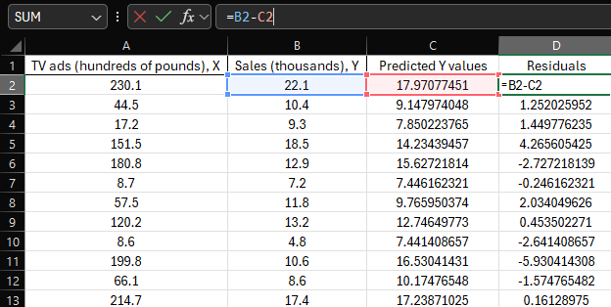
Residual analysis
Residuals were found using previously determined formula to find expected y values
Using these residuals, I created a graph to plot them in relation to the explanatory variable.
Notes:
• found the difference between predicted y values and actual y values
• created a scatter plot graph to display the residuals To make our model easier to analyse
•
• we can see a fairly obvious trend
• As our explanatory variable increases, our variability in the residuals also increases
• Suggests that there is a factor we haven’t taken into account, and our model could be improved

Slide 8



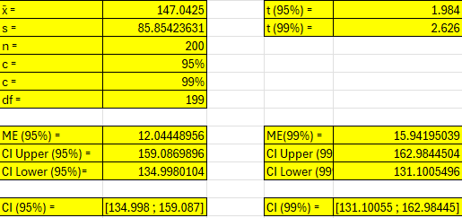
95% and 99% Confidence intervals
Figure 3
Determined sample mean (x bar) and sample standard deviation (s) using excel functions(figures 3 and 4)
Calculated margin of error (me) by multiplying t-critical values (95% and 99%) by sample standard deviation over square root of sample size (figure 5)
Added and subtracted me from the mean to find the confidence intervals: 95% [134.998; 159.087] and 99% [131.10055; 162.98445]
The 99% interval is wider due to the trade-off between higher confidence and a larger margin of error (figure 2)
Figure 4
Figure 5
Figure 2

Slide 9
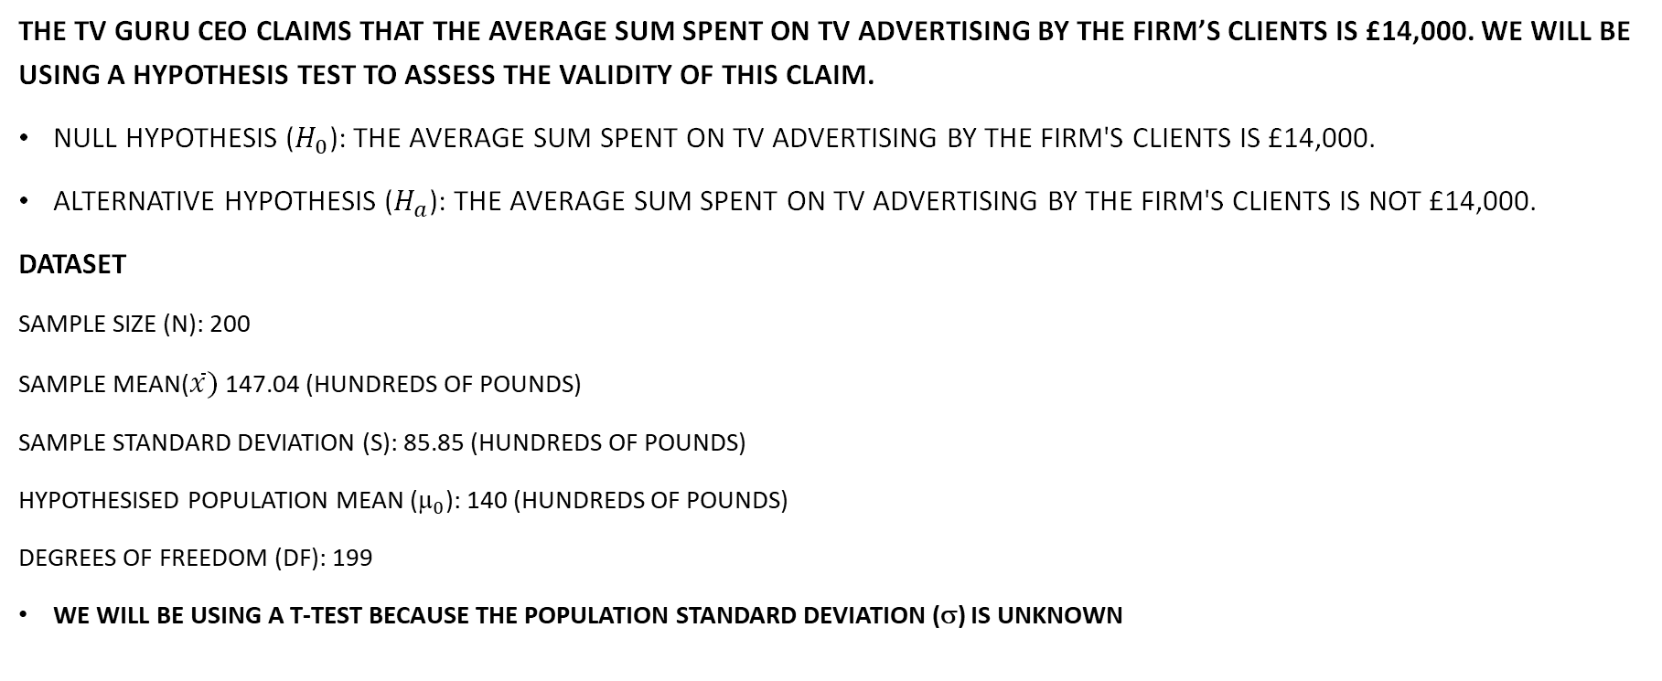
hypothesis test
The TV Guru CEO claims that the average sum spent on TV advertising by the firm’s clients is £14,000. We will be using a hypothesis test to assess the validity of this claim.
Null Hypothesis ($H_{0}$): The average sum spent on TV advertising by the firm's clients is £14,000.
Alternative Hypothesis ($H_{a}$): The average sum spent on TV advertising by the firm's clients is not £14,000.
dataset
Sample size (N): 200
Sample mean($\overline{x})$ 147.04 (hundreds of pounds)
Sample Standard deviation (S): 85.85 (hundreds of pounds)
Hypothesised population mean (${\text{}}_{0}$): 140 (hundreds of pounds)
Degrees of freedom (DF): 199
We will be using a t-Test because the population standard deviation (σ) is unknown

Slide 10
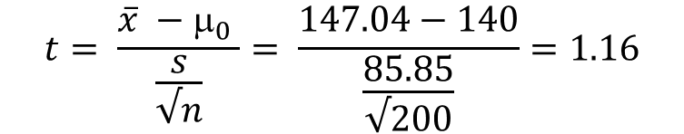
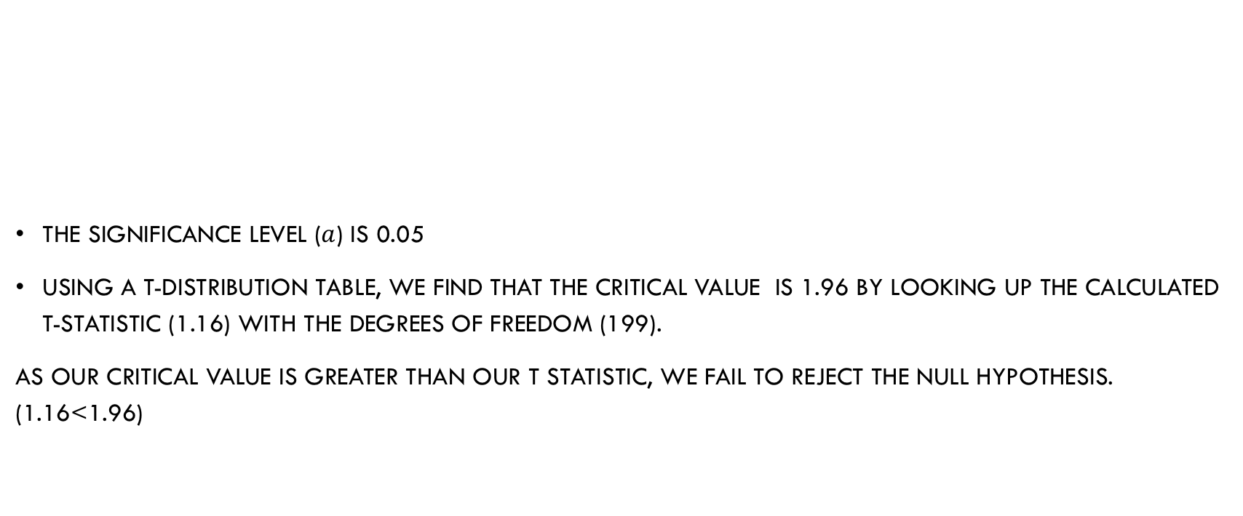
Calculations
$$t= \frac{\overline{x} −{\text{μ}}_{0} }{\frac{s}{√n}}= \frac{147.04−140}{\frac{85.85}{√200}}=1.16$$
The significance level ($a$) is 0.05
Using a t-distribution table, we find that the critical value is 1.96 by looking up the calculated t-statistic (1.16) with the degrees of freedom (199).
As our critical value is greater than our t statistic, we fail to reject the null hypothesis. (1.16<1.96)

Slide 11
Conclusions
There is a moderate positive linear relationship between tv advertising expenditure and sales.
Average TV advertising expenditure is between £13,110 and £16,298 with 99% confidence
The coefficient of determination indicates that 61.19% of the variation of data in sales is explained by TV advertising expenditure
Gained hands-on experience in applying statistical techniques such as linear regression, residual analysis etc.
Improved efficiency in Excel especially with functions regression analysis, creating scatter plots and calculating confidence levels
Team members had varying levels of excel knowledge, leading to manual calculations instead of using built in functions, which caused delays and took extra time to learn

Slide 12
References
Excel Tutorials by EasyClick Academy. (2021, March 15). How to make a scatter plot in Excel [Video]. YouTube. https://www.youtube.com/watch?v=MfEAEmdFOBo
Dr. Elliott Jardin. (2020, July 23). Calculate standard deviation in Excel (30 seconds) [Video]. YouTube. https://www.youtube.com/watch?v=KcCA061tpyk
Aaron Freeman. (2020, October 25). Using Excel - creating a residual plot [Video]. YouTube. https://www.youtube.com/watch?v=EHnkc6evkiQ
The Organic Chemistry Tutor. (2020, June 18). How to calculate the average in Excel [Video]. YouTube. https://www.youtube.com/watch?v=1xD_pdAnU0c
How-To Guide. (2022, February 23). How to Calculate Square Root in Microsoft Excel :Tutorial [Video]. YouTube. https://www.youtube.com/watch?v=DCgSynk_hSQ

